Slide 1
Divide and Conquer II

Slide 2
Divide-and-Conquer
A problem is divided into several (often 2) sub-problems of same type, ideally of about equal size.
The sub-problems are solved (often recursively).
Combine solutions to sub-problems into solution to overall problem.

Slide 3
Geometric Problems

Slide 4
Quickhull Algorithm
Convex hull: smallest convex set that includes given points
Sort points by x-coordinate values
Identify extreme points P₁ and P₂ (leftmost and rightmost)
Splits points into 2 sets S₁ and S₂.
P₂
P₁

Slide 5
Quickhull Algorithm
Compute upper (and lower) hull recursively:
find point P_{max} that is farthest away from line P₁P₂
compute the upper hull of the points outside line P₁P_{max}
compute the upper hull of the points outside line P_{max}P₂
P_{max}
P₂
P₁
Discard points inside P₁ - P₂- P_{max} triangle.

Slide 6
Quickhull Algorithm
compute the upper hull of the points outside line P₁P_{max}
compute the upper hull of the points outside line P_{max}P₂ (no points in set)
P₂
P_{max}
P₁

Slide 7
Efficiency of Quickhull Algorithm
Sorting points in O(n log n) time
Finding point farthest away from line P₁P₂ can be done in linear time using determinant.
Overall Time efficiency:
worst case: Θ(n²) (as quicksort)
average case: Θ(n) (under reasonable assumptions about distribution of points given)

Slide 8
Closest Pair
Assume that your n points are sorted by x-coordinate in one list and by y-coordinate in second list.
If not already, can sort in Θ(n log₂n)
If 2 ≤ n ≤ 3, use brute force.

Slide 9
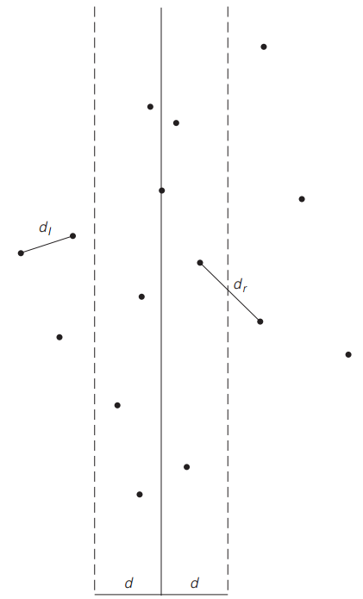
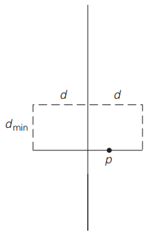
Closest Pair
If n > 3, draw line through median of x-values and divide points into 2 subsets, P_{L} & P_{R}
Apply recursively to P_{L} & P_{R}.
d = min(d_{L},d_{R})
Check pairs within distance d of median.

Slide 10
Closest Pair
d = min(d_{L},d_{R})
For points within distance d in x-direction of median…
…check adjacent pairs in y-sorted list within distance d of each other…
…update d if necessary
At most 6 such points
Notes:
Pseudocode in Textbook

Slide 11
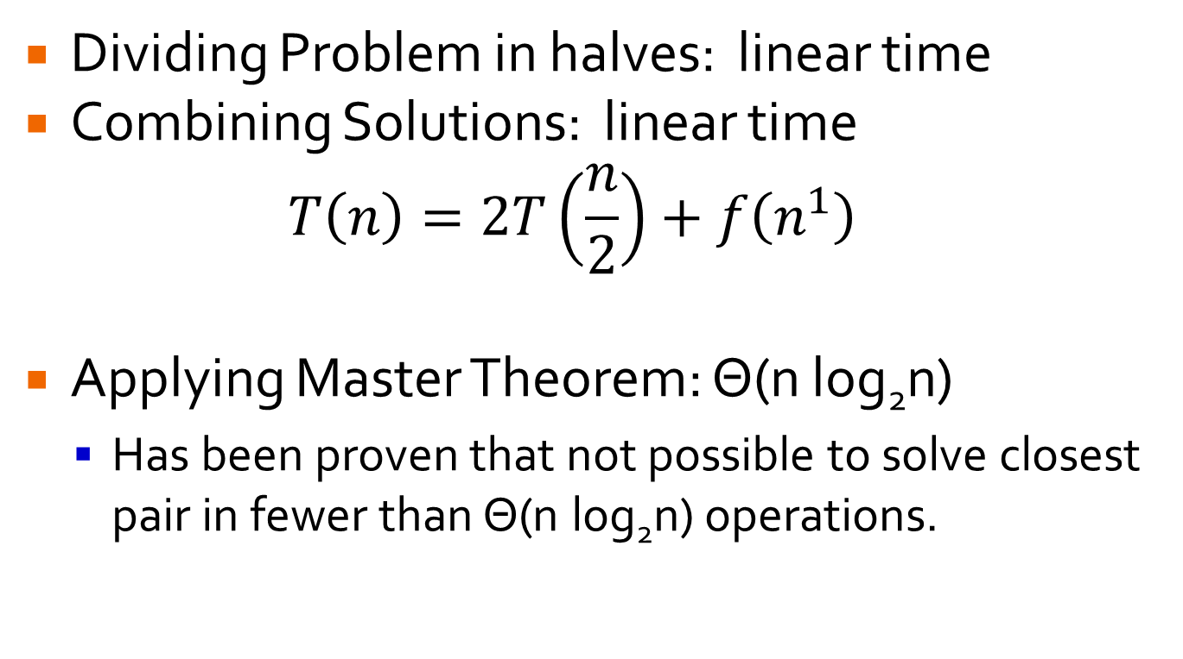
Divide-and-Conquer Closest Pair
Dividing Problem in halves: linear time
Combining Solutions: linear time
$$T\left(n\right)=2T\left(\frac{n}{2}\right)+f\left(n^{1}\right)$$
Applying Master Theorem: Θ(n log₂n)
Has been proven that not possible to solve closest pair in fewer than Θ(n log₂n) operations.

Slide 12
Numerical Problems

Slide 13
Multiplication of Large Integers
Integers too large to store in regular variables
Used in RSA
Naïve algorithm: n² digit multiplications
Divide and Conquer can do better!

Slide 14
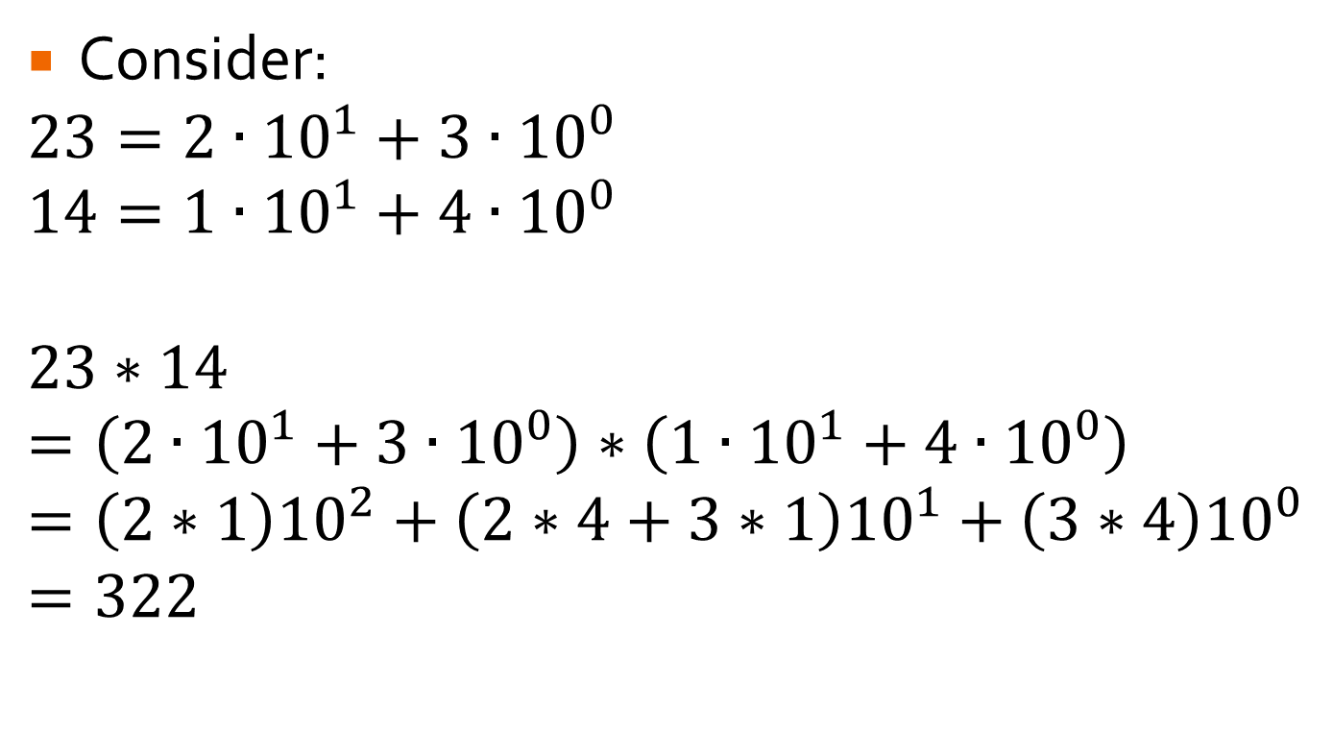
Multiplication of Large Numbers
Consider:
$$23=2∙{10}^{1}+3∙{10}^{0}$$
$$14=1∙{10}^{1}+4∙{10}^{0}$$
$$23∗14$$
$$=\left(2∙{10}^{1}+3∙{10}^{0}\right)∗\left(1∙{10}^{1}+4∙{10}^{0}\right)$$
$$=\left(2∗1\right){10}^{2}+\left(2∗4+3∗1\right){10}^{1}+\left(3∗4\right){10}^{0}$$
$$=322$$
4 multiplications, like naïve but can we do better

Slide 15
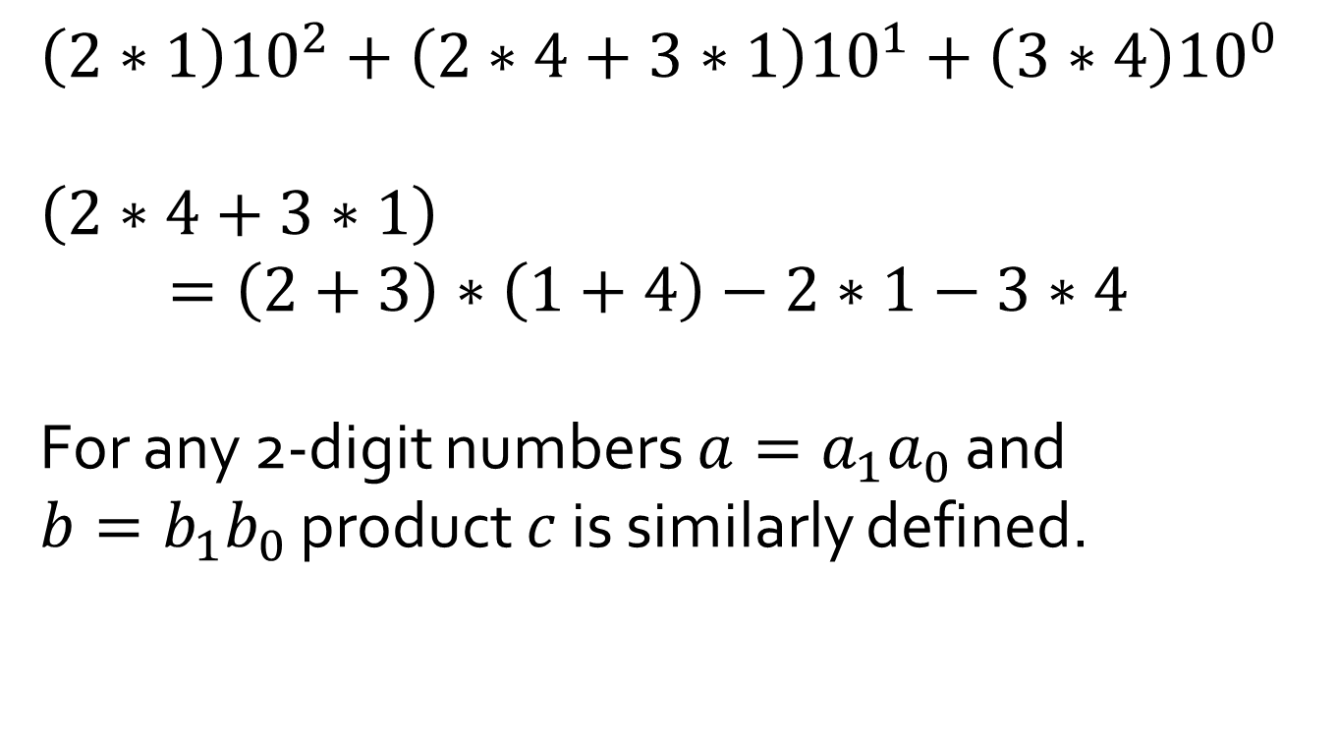
Multiplication of Large Numbers
$$\left(2∗1\right){10}^{2}+\left(2∗4+3∗1\right){10}^{1}+\left(3∗4\right){10}^{0}$$
$$\left(2∗4+3∗1\right)=\left(2+3\right)∗\left(1+4\right)−2∗1−3∗4$$
For any 2-digit numbers $a=a_{1}a_{0}$ and $b=b_{1}b_{0}$ product $c$ is similarly defined.

Slide 16
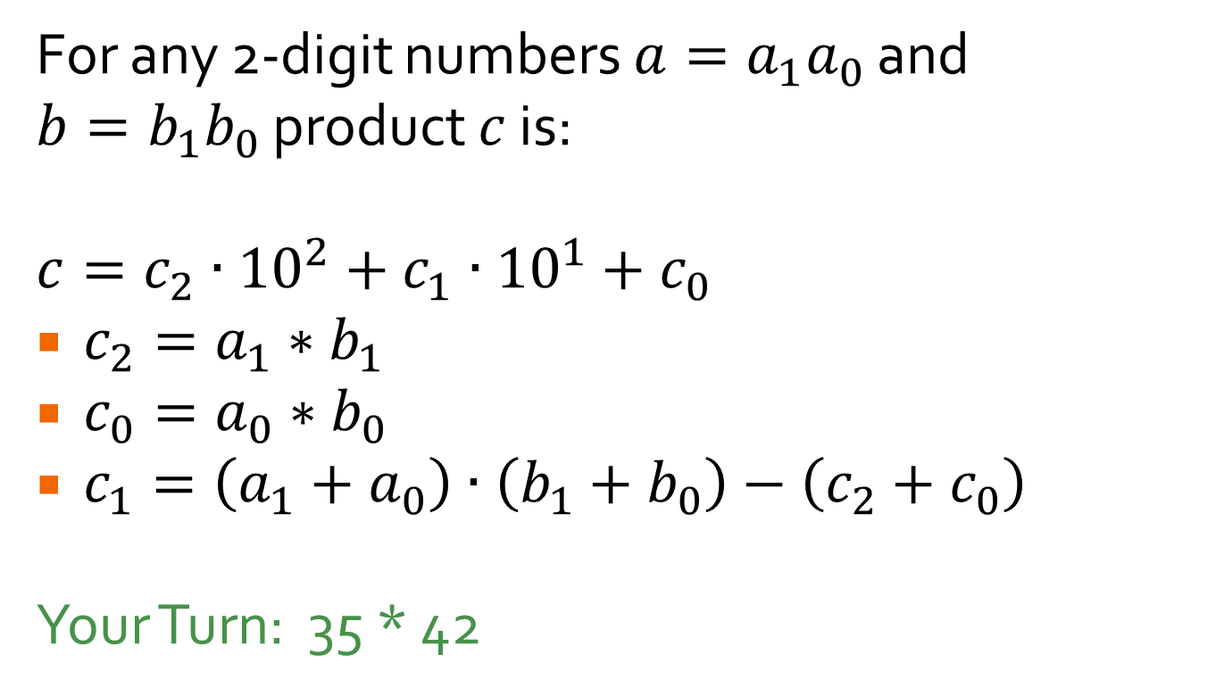
Multiplication of Large Numbers
For any 2-digit numbers $a=a_{1}a_{0}$ and $b=b_{1}b_{0}$ product $c$ is:
$$c=c_{2}∙{10}^{2}+c_{1}∙{10}^{1}+c_{0}$$
$c_{2}=a_{1}∗b_{1}$
$c_{0}=a_{0}∗b_{0}$
$c_{1}=\left(a_{1}+a_{0}\right)∙\left(b_{1}+b_{0}\right)−\left(c_{2}+c_{0}\right)$
Your Turn: 35 * 42

Slide 17
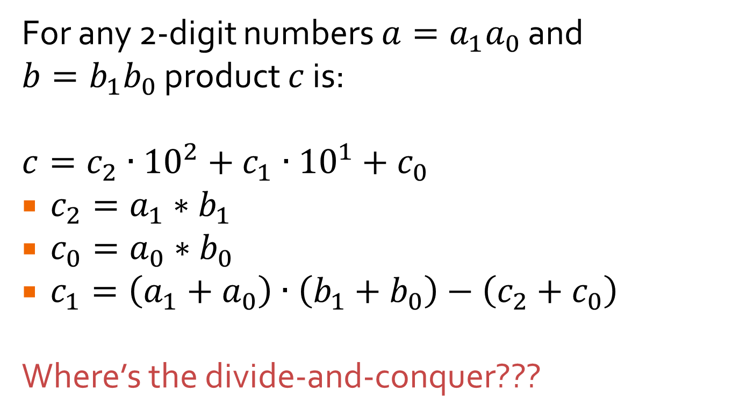
Multiplication of Large Numbers
For any 2-digit numbers $a=a_{1}a_{0}$ and $b=b_{1}b_{0}$ product $c$ is:
$$c=c_{2}∙{10}^{2}+c_{1}∙{10}^{1}+c_{0}$$
$c_{2}=a_{1}∗b_{1}$
$c_{0}=a_{0}∗b_{0}$
$c_{1}=\left(a_{1}+a_{0}\right)∙\left(b_{1}+b_{0}\right)−\left(c_{2}+c_{0}\right)$
Where’s the divide-and-conquer???

Slide 18
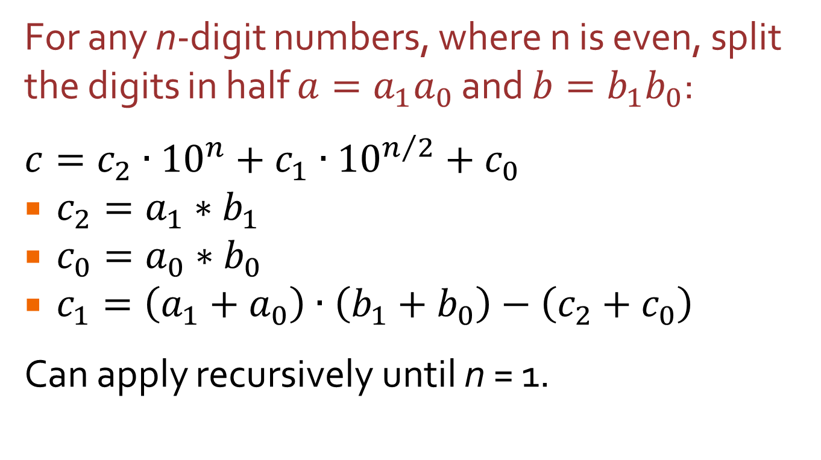
Multiplication of Large Numbers
For any n-digit numbers, where n is even, split the digits in half $a=a_{1}a_{0}$ and $b=b_{1}b_{0}$:
$$c=c_{2}∙{10}^{n}+c_{1}∙{10}^{n/2}+c_{0}$$
$c_{2}=a_{1}∗b_{1}$
$c_{0}=a_{0}∗b_{0}$
$c_{1}=\left(a_{1}+a_{0}\right)∙\left(b_{1}+b_{0}\right)−\left(c_{2}+c_{0}\right)$
Can apply recursively until n = 1.

Slide 19
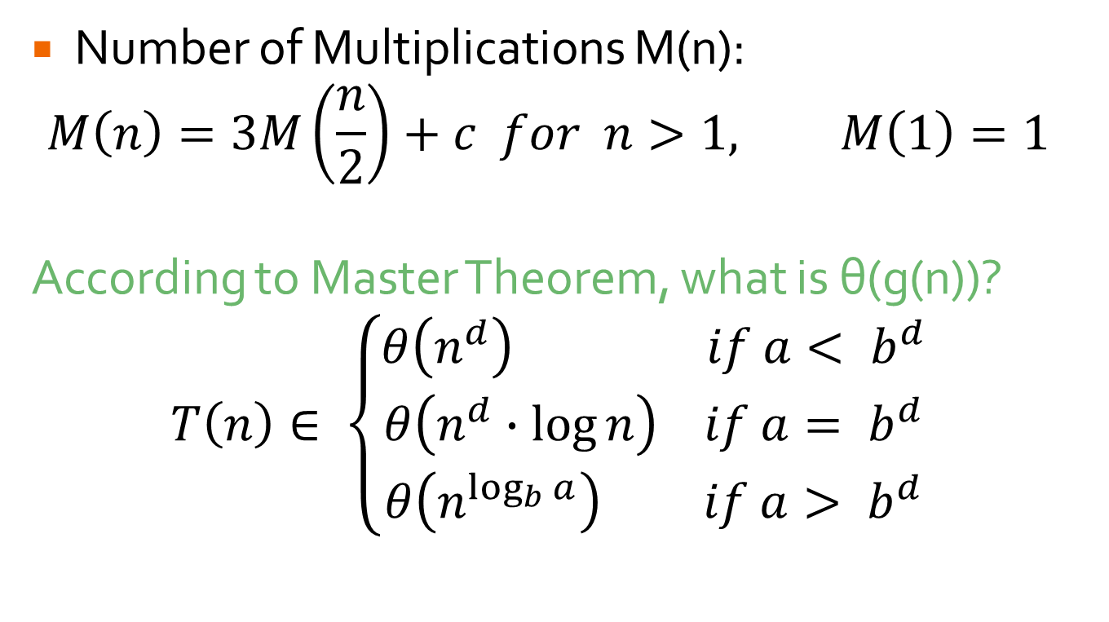
Efficiency of Multiplication
Number of Multiplications M(n):
$$M\left(n\right)=3M\left(\frac{n}{2}\right)+c for n>1, M\left(1\right)=1$$
According to Master Theorem, what is θ(g(n))?
$$T\left(n\right)∈ \left\{\begin{matrix}θ\left(n^{d}\right) if a< b^{d} \\ θ\left(n^{d}∙\log{n}\right) if a= b^{d} \\ θ\left(n^{\log_{b}{a}}\right) if a> b^{d}\end{matrix}\right.$$

Slide 20
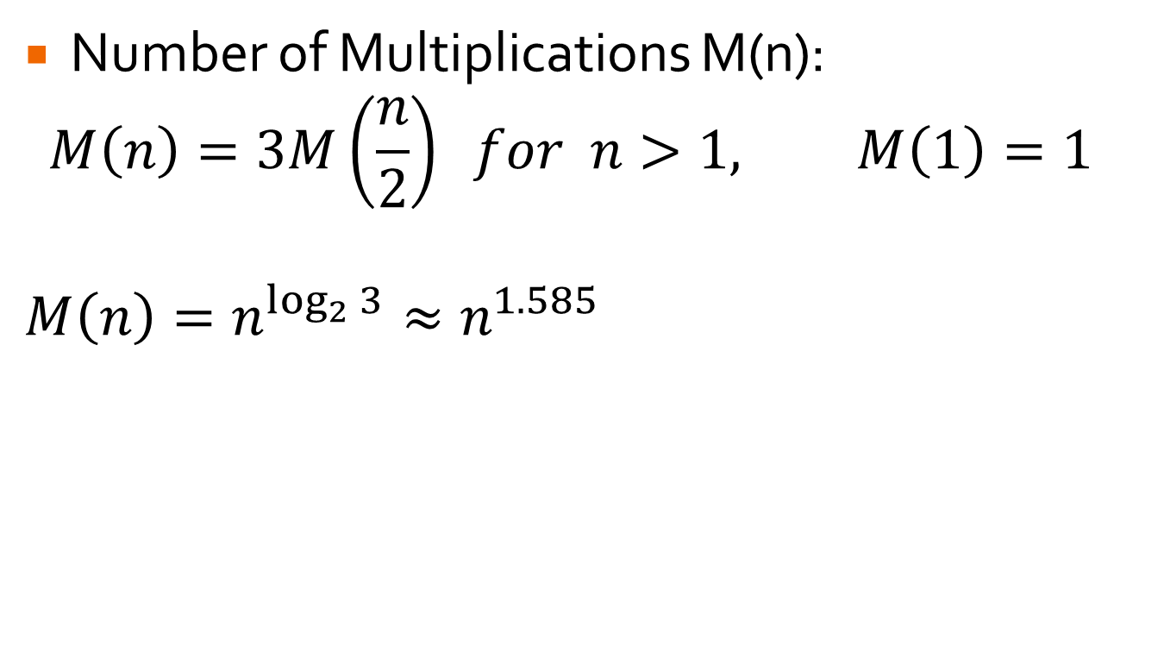
Efficiency of Multiplication
Number of Multiplications M(n):
$$M\left(n\right)=3M\left(\frac{n}{2}\right) for n>1, M\left(1\right)=1$$
$$M\left(n\right)=n^{\log_{2}{3}}≈n^{1.585}$$

Slide 21
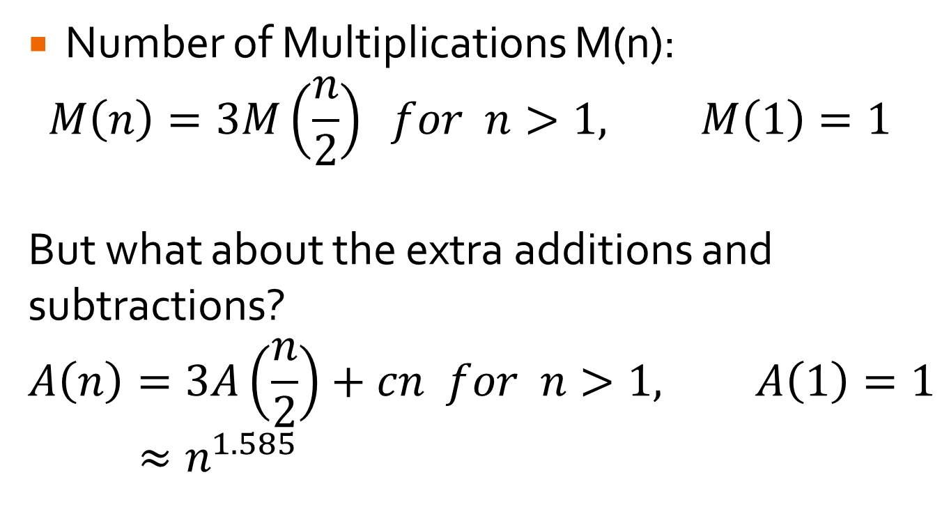
Efficiency of Multiplication
Number of Multiplications M(n):
$$M\left(n\right)=3M\left(\frac{n}{2}\right) for n>1, M\left(1\right)=1$$
But what about the extra additions and subtractions?
$$A\left(n\right)=3A\left(\frac{n}{2}\right)+cn for n>1, A\left(1\right)=1$$
$≈n^{1.585}$

Slide 22
Efficiency of Multiplication
Depending on system, outperforms conventional method at 8 digits.
Switch to conventional at crossover point.
More than twice as fast on 300-digit nums.
Object-Oriented Languages have built-in classes.
Until 1960, assumed Θ(n²) was limit

Slide 23
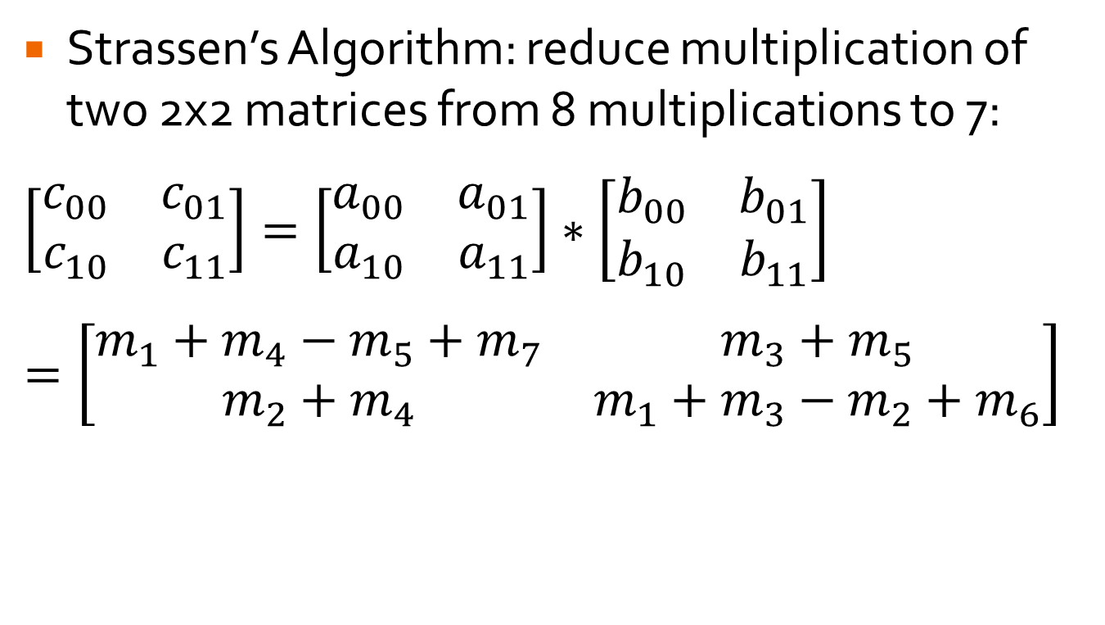
Matrix Multiplication
Strassen’s Algorithm: reduce multiplication of two 2x2 matrices from 8 multiplications to 7:
$$\left[\begin{matrix}c_{00} & c_{01} \\ c_{10} & c_{11}\end{matrix}\right]=\left[\begin{matrix}a_{00} & a_{01} \\ a_{10} & a_{11}\end{matrix}\right]∗\left[\begin{matrix}b_{00} & b_{01} \\ b_{10} & b_{11}\end{matrix}\right]$$
$$=\left[\begin{matrix}m_{1}+m_{4}−m_{5}+m_{7} & m_{3}+m_{5} \\ m_{2}+m_{4} & m_{1}+m_{3}−m_{2}+m_{6}\end{matrix}\right]$$

Slide 24
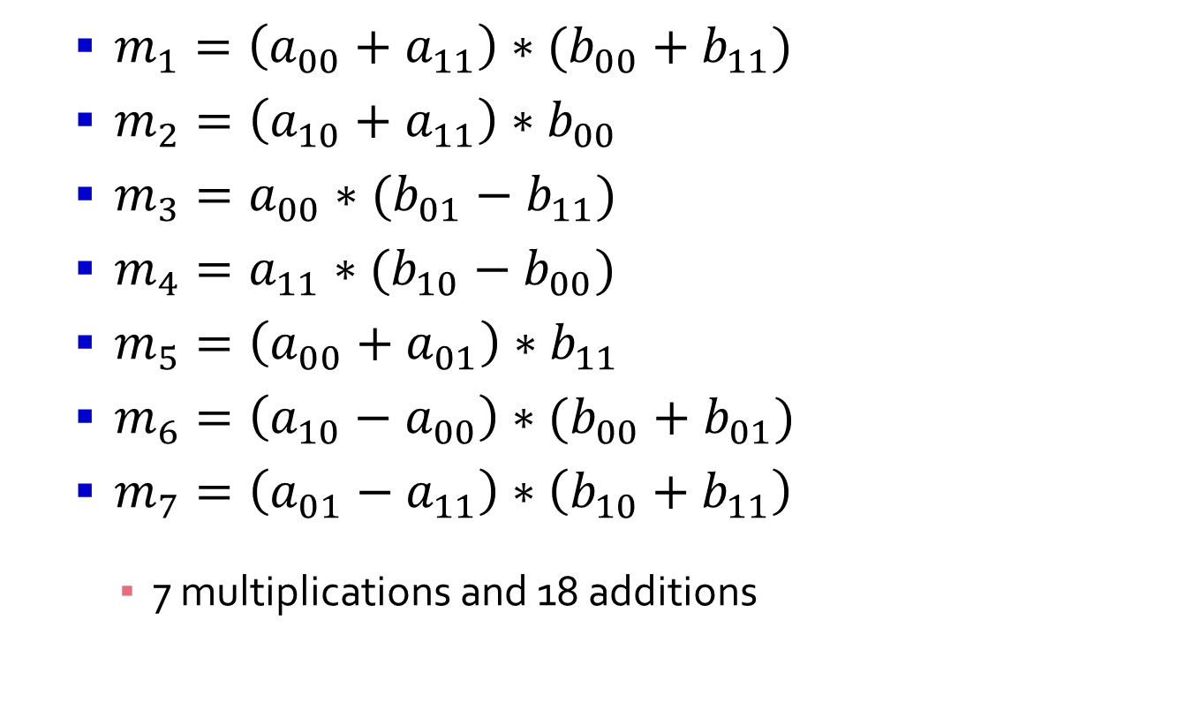
Strassen’s Algorithm
$m_{1}=\left(a_{00}+a_{11}\right)∗(b_{00}+b_{11})$
$m_{2}=\left(a_{10}+a_{11}\right)∗b_{00}$
$m_{3}=a_{00}∗(b_{01}−b_{11})$
$m_{4}=a_{11}∗(b_{10}−b_{00})$
$m_{5}=\left(a_{00}+a_{01}\right)∗b_{11}$
$m_{6}=\left(a_{10}−a_{00}\right)∗(b_{00}+b_{01})$
$m_{7}=\left(a_{01}−a_{11}\right)∗\left(b_{10}+b_{11}\right)$
7 multiplications and 18 additions

Slide 25
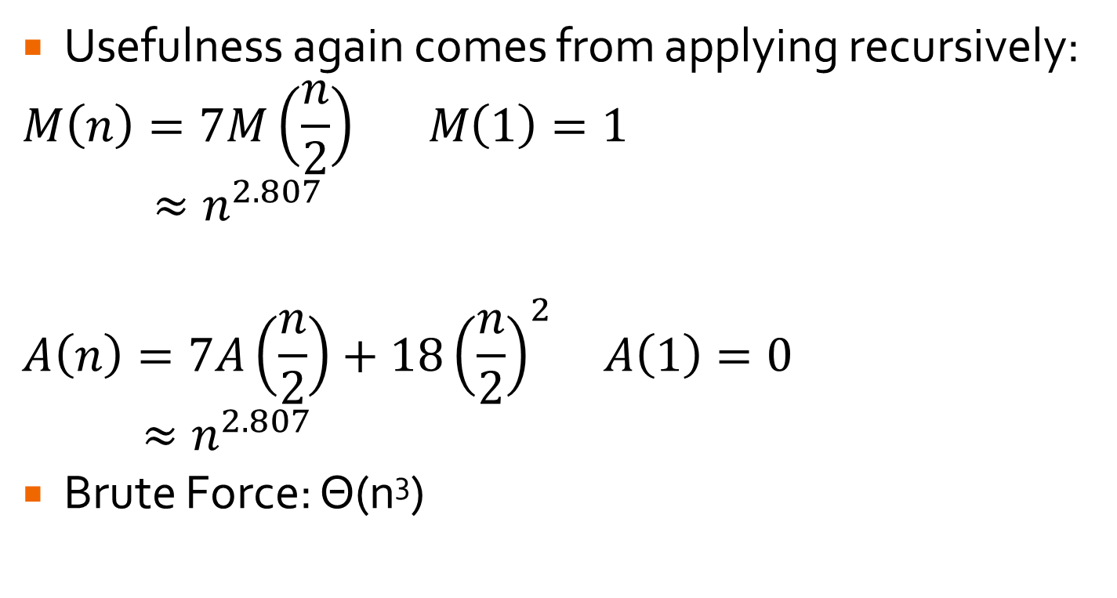
Strassen’s Algorithm
Usefulness again comes from applying recursively:
$$M\left(n\right)=7M\left(\frac{n}{2}\right) M\left(1\right)=1$$
$$≈n^{2.807}$$
$$A\left(n\right)=7A\left(\frac{n}{2}\right)+18{\left(\frac{n}{2}\right)}^{2} A\left(1\right)=0$$
$$≈n^{2.807}$$
Brute Force: Θ(n³)

Slide 26
Binary Tree Traversals

Slide 27
Binary Trees – Divide and Conquer
34
Left Subtree
Right Subtree
19
50
1
21
46
87

Slide 28
Traversing a BST
Pre-Order
In-Order
Post-Order
34
19
50
1
21
46
87

Slide 29
Traversing a BST
Height(T)
if T is empty
return 0
else
return max(Height(T_{left}), Height(T_{right}))+1
Which operation is executed most?

Slide 30
Traversing a BST
Height(T)
if T is empty
return 0
else
return max(Height(T_{left}), Height(T_{right}))+1
Which operation is executed most?
Comparisons: C(n) = 2n+1
Additions: A(n) = n

Slide 31
BST Algorithms
Divide-and-Conquer: anything that requires a full traversal.
Variable-Size-Decrease: anything that requires just a single path from root to leaf.
Insert, Search

